Slide 1
Big Data Analytics
Big Data
Batch A – group 12

Slide 2
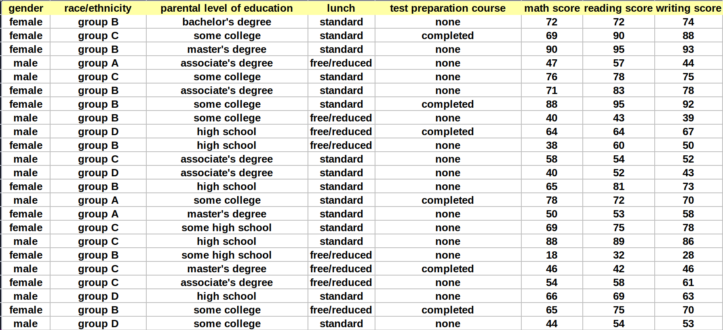
Dataset: Student Performance in Exams

Slide 3
About our dataset
Context
Description
Inspiration
Number of observations – 1000
Number of features – 8
To understand the influence of the parent's background, test preparation etc on students performance
Marks secured by the students

Slide 4

Member Class
This class is used to create objects that represent individual members with various attributes related to their education and scores.
The class provides getter and setter methods for each attribute to access and modify their values. The getter methods retrieve the values of the attributes, while the setter methods allow you to change the values

Slide 5

Initialization and configuration of a Spark application

Slide 6

Transforming our dataset into a new member object using the map method

Slide 7

All Student Filter

Slide 8
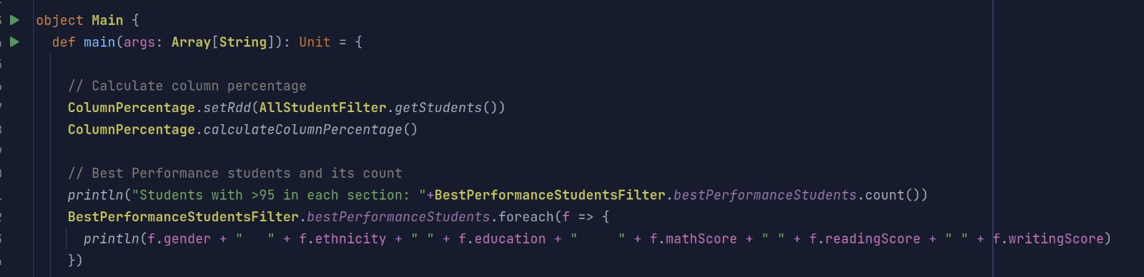
Analysis: main object
1

Slide 9
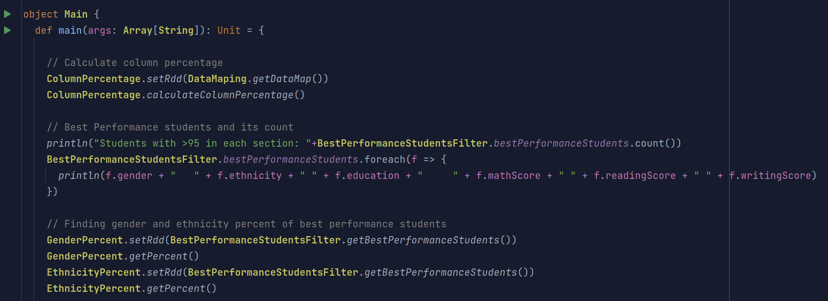

Analysis: main object
2

Slide 10
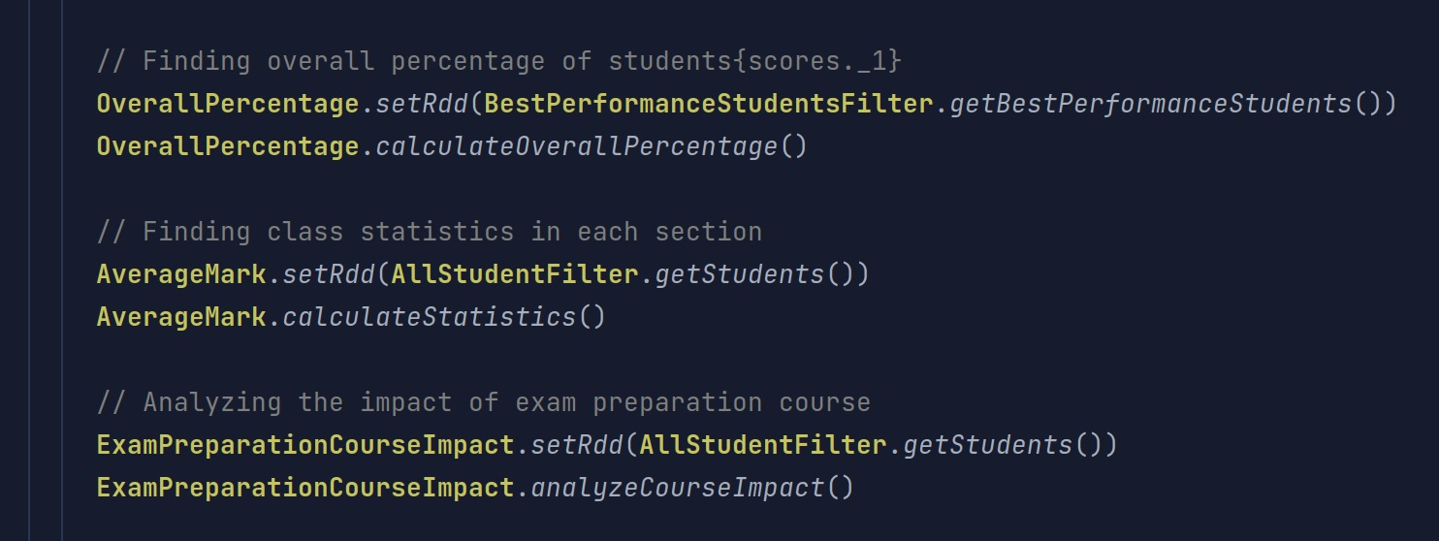
Analysis: main object
3

Slide 11
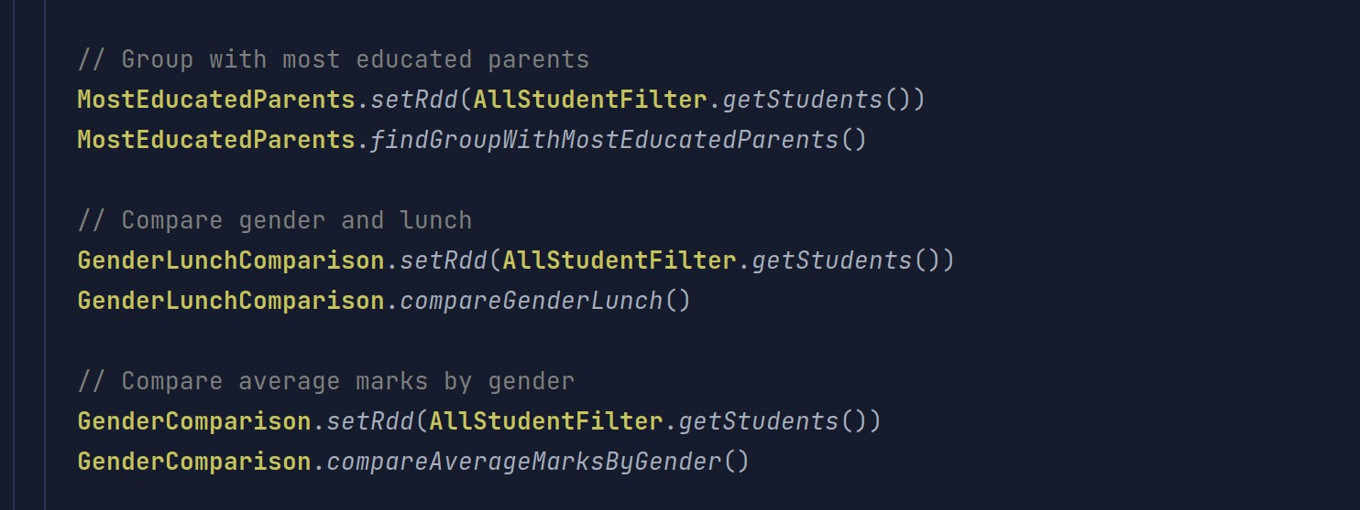
Analysis: main object
4

Slide 12

Analysis: Calculating the percentage of all entries in each column

Slide 13
My observations: 1. Gender ratio almost evenly poised 2. Dominated by students from group – C 3. Most of the students' parents are well educated
Column Percentage
Gender : Map(male -> 48.25, female -> 51.74)
Ethnicity : Map(group E -> 13.98, group B -> 18.98, group C -> 31.86,
group A -> 8.99, group D -> 26.17)
Education : Map(high school -> 19.58, master's degree -> 5.89,
bachelor's degree -> 11.78, some high school -> 17.88,
some college -> 22.67, associate's degree -> 22.17)
Lunch : Map(free/reduced -> 35.46, standard -> 64.53)
Preparation Course : Map(completed -> 35.76, none -> 64.23)

Slide 14

Analysis: Filtering out the best performance students from the test

Slide 15
My observations: 1. Dominated by female 2. Students belonging to group – D, E performed better than other groups
Best Performance Students
Students with >95 in each section: 10
female group E bachelor's degree 99 100 100
female group C bachelor's degree 96 100 100
female group D some high school 97 100 100
female group E bachelor's degree 100 100 100
male group D some college 100 97 99
female group D some college 98 100 99
female group C associate's degree 96 96 99
female group B bachelor's degree 97 97 96
male group E bachelor's degree 100 100 100
female group E associate's degree 100 100 100

Slide 16
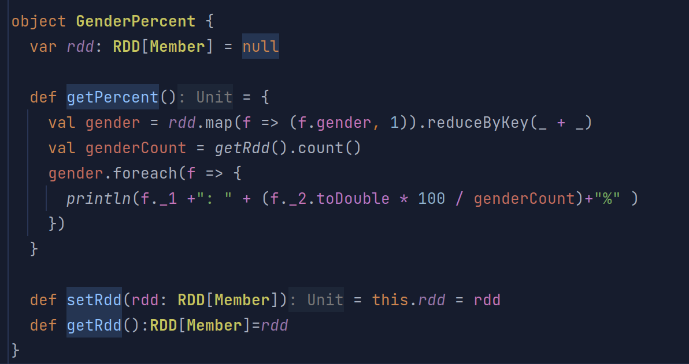
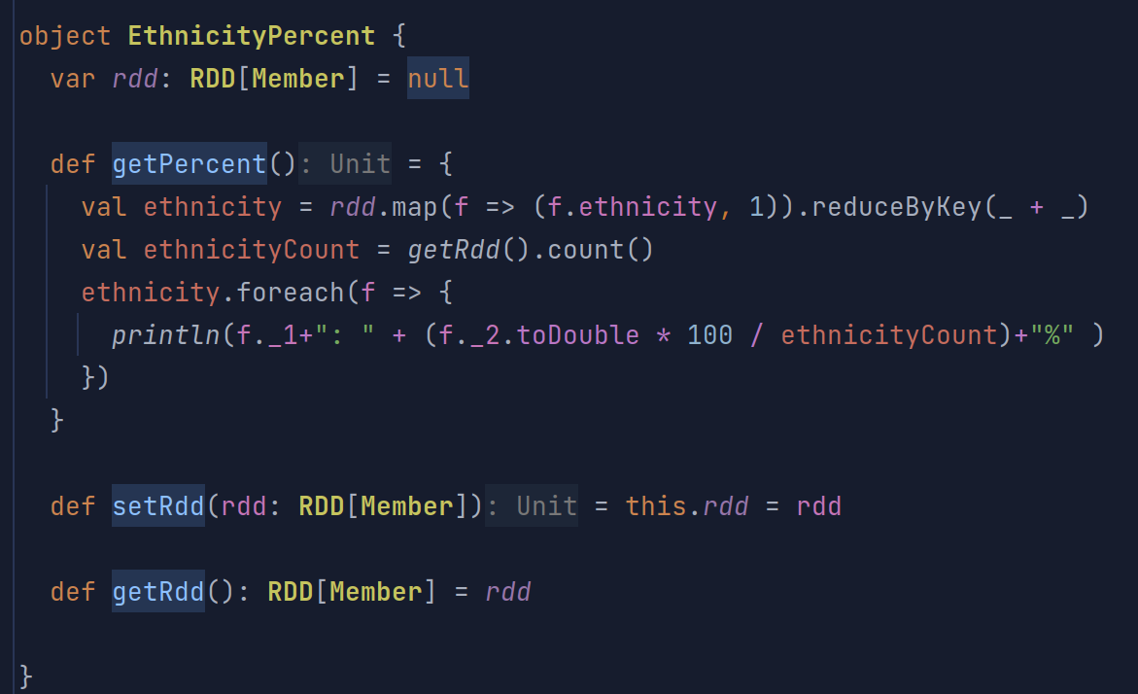
Analysis: Gender and Ethnicity percent of best performance students

Slide 17
My observations: 1. Female dominate the best performance students list 2. Students from group – D,E account for 70% of best performance students
Gender & Ethnicity percentage of best performance students
Male : 20.0%
Female : 80.0%
group B: 10.0%
group D: 30.0%
group E: 40.0%
group C: 20.0%

Slide 18

Impact of parent’s Education level

Slide 19
Impact of Parent’s education level on student performance
Parents Education Level: some high school
Math Average: 63.50
Reading Average: 66.94
Writing Average: 64.89
Parents Education Level: bachelor's degree
Math Average: 69.39
Reading Average: 73.00
Writing Average: 73.38
Parents Education Level: master's degree
Math Average: 69.75
Reading Average: 75.37
Writing Average: 75.68
Parents Education Level: associate's degree
Math Average: 67.88
Reading Average: 70.93
Writing Average: 69.90
Parents Education Level: high school
Math Average: 62.14
Reading Average: 64.70
Writing Average: 62.45
Parents Education Level: some college
Math Average: 67.05
Reading Average: 69.43
Writing Average: 68.84
* Parents Level of education plays a big role in the students’ performance

Slide 20

Ethnic Group with most educated parents

Slide 21
My observation:
Ethnic group with most Educated parents
Groups with the most educated parents:
group D

Slide 22
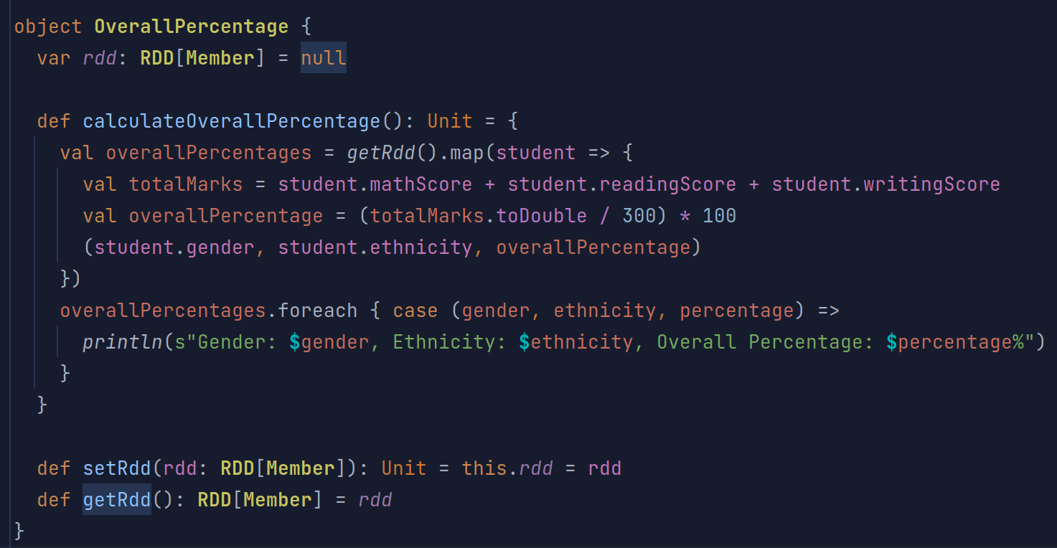
Analysis: Overall percentage of the best performance students in the test

Slide 23
My observations: Students from group – E top the chart with 3 students scoring 100% in all subjects
Overall percentage of best performance students
Gender: female, Ethnicity: group E, Overall Percentage: 99.67%
Gender: female, Ethnicity: group C, Overall Percentage: 98.67%
Gender: female, Ethnicity: group D, Overall Percentage: 99.0%
Gender: female, Ethnicity: group E, Overall Percentage: 100.0%
Gender: male, Ethnicity: group D, Overall Percentage: 98.67%
Gender: female, Ethnicity: group D, Overall Percentage: 99.0%
Gender: female, Ethnicity: group C, Overall Percentage: 97.0%
Gender: female, Ethnicity: group B, Overall Percentage: 96.67%
Gender: male, Ethnicity: group E, Overall Percentage: 100.0%
Gender: female, Ethnicity: group E, Overall Percentage: 100.0%

Slide 24

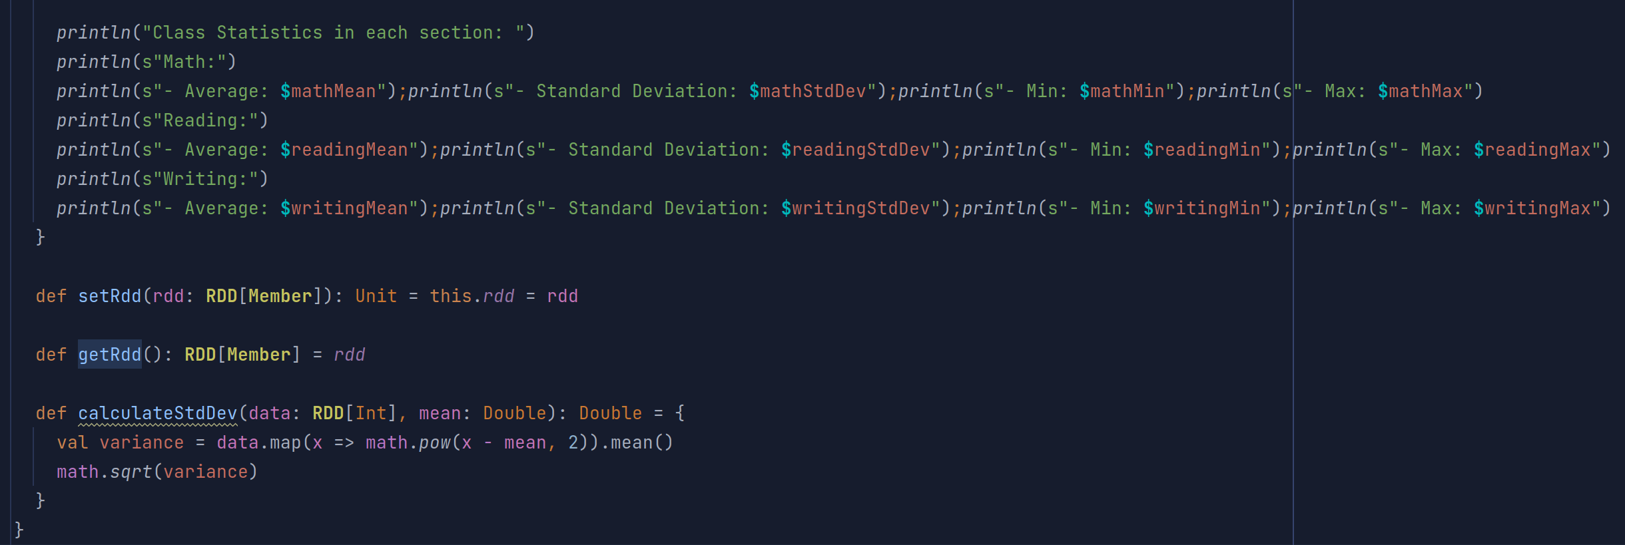
Overall statistics of the Data

Slide 25
My observations: Reading has the highest-class average among other sections also with least deviation from its average
Overall statistics of the students’ performance
Class Statistics in each section:
Math:-
-Average: 66.07292707292707
-Standard Deviation: 15.156449398368707
-Min: 0
-Max: 100
Reading:-
-Average: 69.16283716283709
- Standard Deviation: 14.586900968423523
- Min: 17
- Max: 100
Writing:-
-Average: 68.05494505494505
- Standard Deviation: 15.180498361104172
- Min: 10
- Max: 100

Slide 26

Performance of each Ethnic group

Slide 27
My observations: Students of group –E perform better in all the subjects than other groups in the school
Overall percentage of each Ethnic group
Ethnicity: group B
Math Average: 63.45
Reading Average: 67.35
Writing Average: 65.60
Ethnicity: group A
Math Average: 61.50
Reading Average: 64.66
Writing Average: 62.74
Ethnicity: group D
Math Average: 67.36
Reading Average: 70.03
Writing Average: 70.15
Ethnicity: group E
Math Average: 73.82
Reading Average: 73.03
Writing Average: 71.41
Ethnicity: group C
Math Average: 64.46
Reading Average: 69.10
Writing Average: 67.83

Slide 28
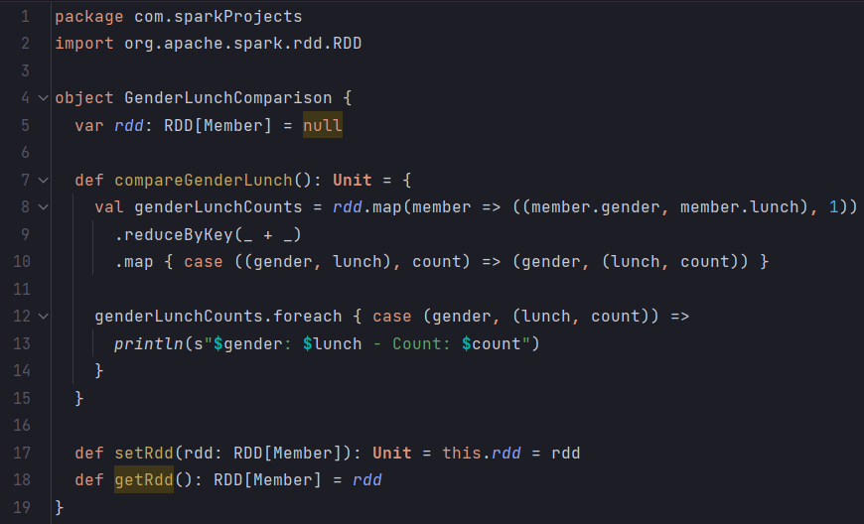
Analysis on gender count based on Lunch type

Slide 29
My observations: Most of the students prefer the Standard Lunch over the Free/Reduced Lunch
Gender count of students based on Lunch type
male: free/reduced - Count: 166
male: standard - Count: 316
female: standard - Count: 329
female: free/reduced - Count: 189

Slide 30
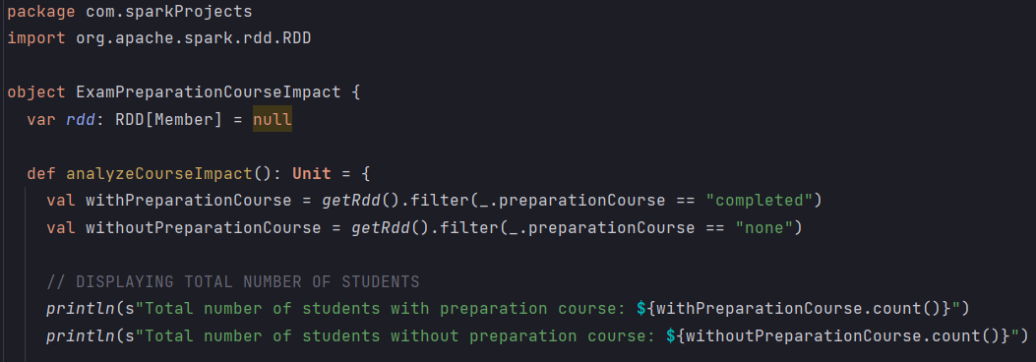
Analysis on performance based on Exam preparation course
Total number of students with preparation course: 358
Total number of students without preparation course: 642

Slide 31
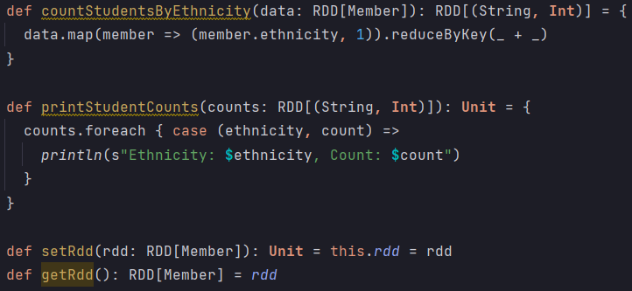
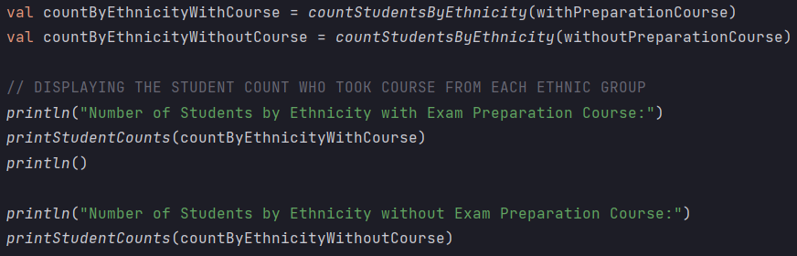
Analysis on performance based on Exam preparation course
Number of Students by Ethnicity with Exam Preparation Course:
Ethnicity: group B, Count: 68
Ethnicity: group A, Count: 31
Ethnicity: group D, Count: 82
Ethnicity: group E, Count: 60
Ethnicity: group C, Count: 117
Number of Students by Ethnicity without Exam Preparation Course:
Ethnicity: group B, Count: 122
Ethnicity: group A, Count: 58
Ethnicity: group D, Count: 180
Ethnicity: group E, Count: 80
Ethnicity: group C, Count: 202

Slide 32
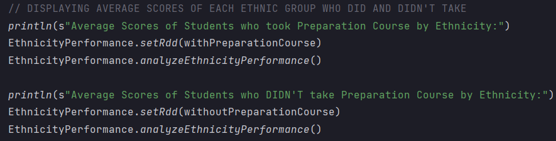
Analysis on performance based on Exam preparation course
Ethnicity: group B
Math Average: 67.19
Reading Average: 72.85
Writing Average: 71.88
Ethnicity: group A
Math Average: 68.26
Reading Average: 71.03
Writing Average: 70.90
Ethnicity: group D
Math Average: 69.79
Reading Average: 74.15
Writing Average: 76.66
Ethnicity: group E
Math Average: 77.43
Reading Average: 76.67
Writing Average: 75.98
Ethnicity: group C
Math Average: 67.50
Reading Average: 73.66
Writing Average: 74.45
Ethnicity: group B
Math Average: 61.37
Reading Average: 64.29
Writing Average: 62.10
Ethnicity: group A
Math Average: 58.09
Reading Average: 61.28
Writing Average: 58.28
Ethnicity: group D
Math Average: 66.26
Reading Average: 68.16
Writing Average: 67.18
Ethnicity: group E
Math Average: 71.11
Reading Average: 70.30
Writing Average: 67.98
Ethnicity: group C
Math Average: 62.71
Reading Average: 66.47
Writing Average: 63.99

Slide 33

Analysis on performance based on Exam preparation course
Average Scores with Exam Preparation Course:
Math: 69.69553072625695
Reading: 73.89385474860339
Writing: 74.41899441340786
Average Scores without Exam Preparation Course:
Math: 64.0778816199377
Reading: 66.53426791277242
Writing: 64.50467289719627

Slide 34
Analysis on student performance based on Exam preparation course
My observations: From the results we can infer the following:
i) Choosing test preparation course does impact the student’s performance.
ii) Students who chose the test preparation course has better performance than those who didn’t.

Slide 35

Analysis on average scores based on gender

Slide 36
My observations: In Math on average Male students have score better than Female In Reading, female students have done better than male students In Writing also, female students have done better than male students
Analysis on average marks based on gender
Average Marks by Gender:
Male: Math - 68.68, Reading - 65.46, Writing - 63.32
Female: Math - 63.63, Reading - 72.6, Writing - 72.46

